Slide 1
Therapeutic Effects of Psychedelics
Kevin Krupp

Slide 2
What are Psychedelics?
Powerful psychoactive substances that lead to altered states of consciousness effecting
Perception
Mood
Affect numerous cognitive processes.
Generally considered physiologically safe and do not lead to dependence or addiction.
Their origin predates written history, and they were employed by early cultures in many sociocultural and ritual contexts.

Slide 3
Altered States of Consciousness (ASC)
“Mental state induced by any psychological, physiological, or pharmacological manipulations that significantly deviates from normal waking consciousness” (Ludwig 1966)
Hypothesized ASC induced intentionally (drugs, hypnosis…) and from diseases share a common core dimension
Testing done by Dittrich (1985) determined 3 primary etiology-independent dimensions
1. Oceanic Boundlessness
2. Anxious ego-dissolutions
3. Visionary restructuralization

Slide 4
Oceanic Boundlessness
Reflects a highly pleasurable state of self-dissolution and comprises items that measure alterations of ego-boundaries, an experience of unity and transcendence of space and time, spiritual experiences, a sense of intuitive understanding, and changes in emotions ranging from heightened mood to bliss and ecstasy.
High OBN scores may be indicative of mystical experiences, as described in the scientific literature on the psychology of religion (Forman 1990).
2. Anxious ego-dissolutions
State of anxious ego-dissolution that is characterized by disintegration of the coherent self/ego or separation of the self from the world, loss of self control over one’s autonomy, feelings of estrangement from the environment, cognitive impairment, anxiety or panic, and motor disturbances or catatonia.
High AED scores can reflect a highly unpleasant state that is often referred to colloquially and in the literature as “bad trip.”
3. Visionary restructuralization
Assessing elementary and complex pseudohallucinations or true hallucinations, illusions, audio-visual synesthesias, changed meaning of percepts, vivid recollection of memories and imagery from memory, and facilitated imagination.

Slide 6
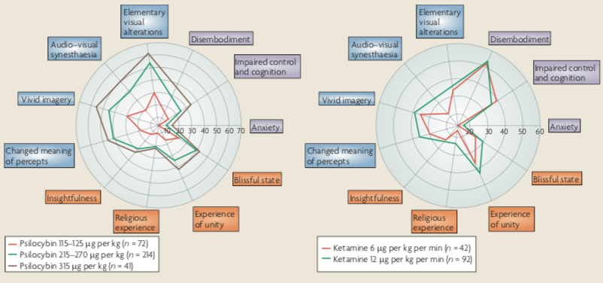

Slide 7
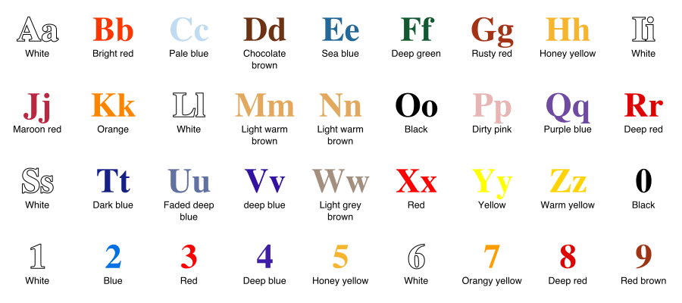
Synesthesia - stimulation of one sensory or cognitive pathway leads to automatic, involuntary experiences in a second sensory or cognitive pathway.
Projective synesthesia: See actual colors, forms, or shapes when stimulated
Associative synesthesia: people who feel a very strong and involuntary connection between the stimulus and the sense that it triggers.

Slide 8
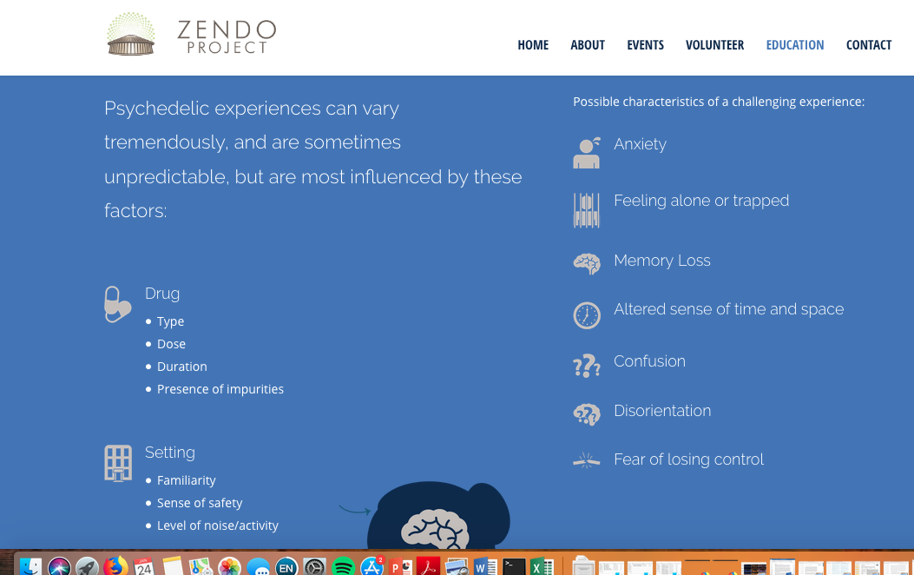
https://www.zendoproject.org/education/

Slide 9
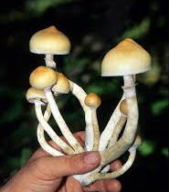
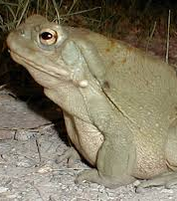
Where are they found?
Many found in compounds produced by various plants/fungi/animals
DMT

Slide 10
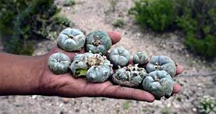
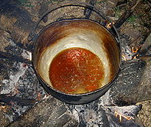
Traditional Uses
Amazonian tribes – Ayahuasca
Native American tribes – Peyote
Ancient Greece – Kykeon
Hindusim - Soma

Slide 11
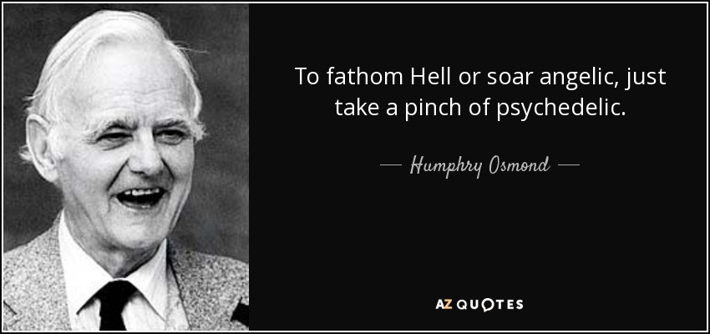
Scientific History of Psychedelics

Slide 12
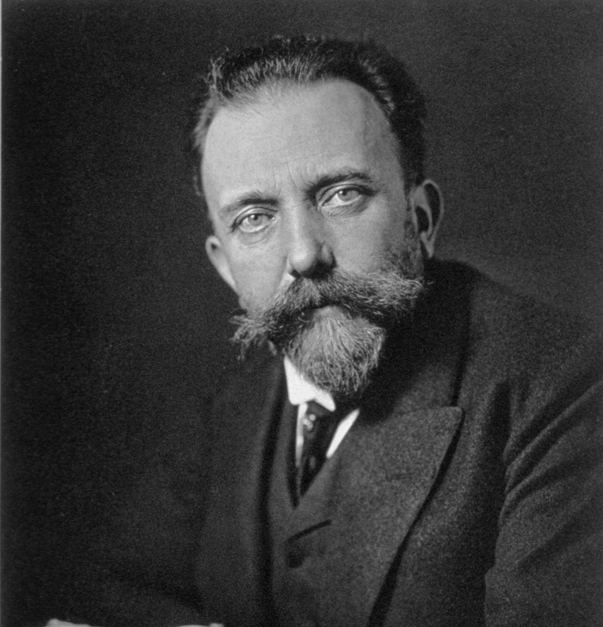
Arthur Heffter
Isolated mescaline in 1897 – self tested peyote and mescaline to determine if it was active compound

Slide 13
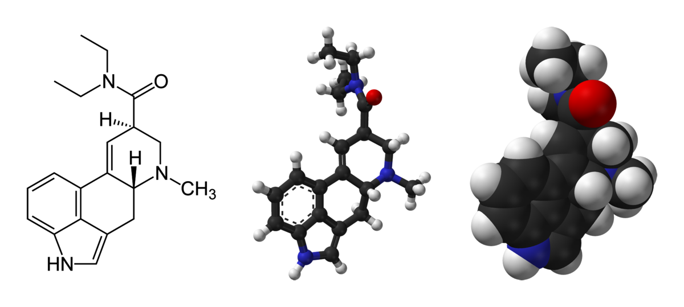
Albert Hoffman (1943)
Discovered LSD accidently
Bicycle Day
Found Psilocybin was psychoactive compound
Onset duration
5-HT found in brain in 1953
Structural similarities lead to hypothesis that LSD may be interfering with 5-HT
Brain chemistry effects behavior
Initially model for mental illness

Slide 14
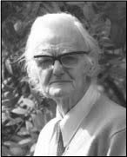
Humphry Osmond – British psychiatrist in 1950’s
Coined term “psychedelics”
”Mind Manifesting”
Psyche – ”mind”
Delos – “manifest”
Early work focused on treating alcoholism using LSD
Delirium tremens
50% success
Bill Wilson one of his patients
Founder of Alcoholics Anonymous

Slide 15
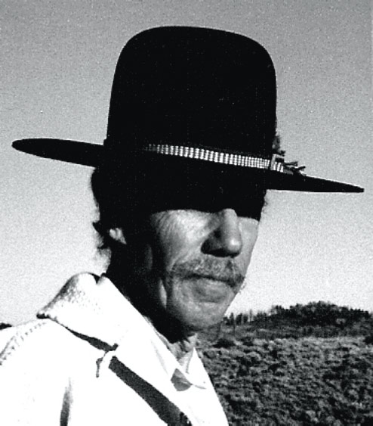
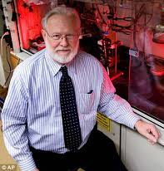
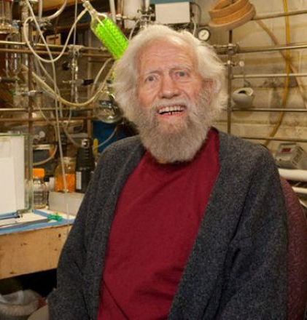
Darrell Lemaire
David Nichols
Sasha Shulgin
(Synthesized DOI as well)
Synthesized MDMA around the same time
suspecting it may have therapeutic value ~1976

Slide 16
Serotonergic
Psychedelics
5-HT2A Agonists
Lysergic Acid Diethylamide (LSD)
K_{i} 5-HT_{2A} (nM) = 2.4
Human dose = .06 - .20 mg
N,N-Dimethyltryptamine (DMT)
-K_{i} 5-HT_{2A} (nM) = 237
Psilocybin → Psilocin
K_{i} 5-HT_{2A} (nM) = 15- 25
Human dose = 10 – 15 mg
Mescaline
K_{i} 5-HT_{2A} (nM) = 550
Human dose = 200 – 400 mg
DOI
K_{i} 5-HT_{2A} (nM) = 0.7
Human dose = 1.5 – 3.0 mg

Slide 17
(Nichols 2017) Psychedelic Neuroscience

Slide 18
5-HT_{2A} Receptor Functional selectivity
Most widely expressed 5-HT receptor in mammals found in every tissue type examined
IP₃ and Phospholipase C pathways
↑ [Ca⁺⁺]
↑ Arachidonic Acid (AA)
Extracellular signal-related Kinase signaling
β-arrestin transduction
Hallucinogenic agonists
**Ser280 phosphorylation**

Slide 19
5-HT2A Receptor - Localization
Adult macaque monkey (Area 46- Prefrontal Cortex)
5-HT2A in almost all, if not all pyramidal neurons
layers II, III, V (primary output), VI
Includes dendrite branches in layer I
5-HT2A not in Layer IV (thalamus input)
Found pre and post synaptically

Slide 20
5-HT2A density highest on Apical Dendrites
--> less on the cell bodies
P = Pyramidal cells
NP = Non-pyramidal
* = unlabeled pyramidal cells

Slide 21
Medium (open arrow head) and large (*) inhibitory interneurons
some Calbindin⁺

Slide 23
Psilocybin
5-HT2A KO = no behavioral effects
Pretreatment with Ketanserin (5-HT2A antagonist) = no behavioral effects
Layer V cortical neurons enriched in 5-HT2A
GABAergic inhibitory neurons contain them as well

Slide 24
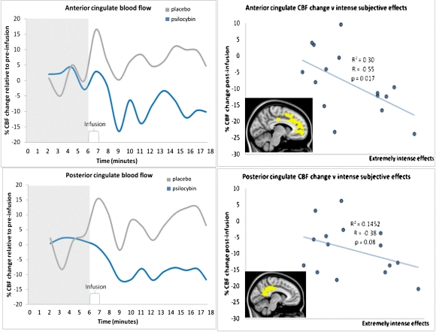
Decreased activity in the ACC/medial prefrontal cortex (mPFC) was a consistent finding
Magnitude of this decrease predicted the intensity of the subjective effects
*Potency of serotonergic psychedelics also correlated with affinity for 5-HT2A*
Regions consistently deactivated w/ Psilocybin have unusually high metabolic activity under “normal conditions”
PCC 20% higher metabolism than other brain regions

Slide 25
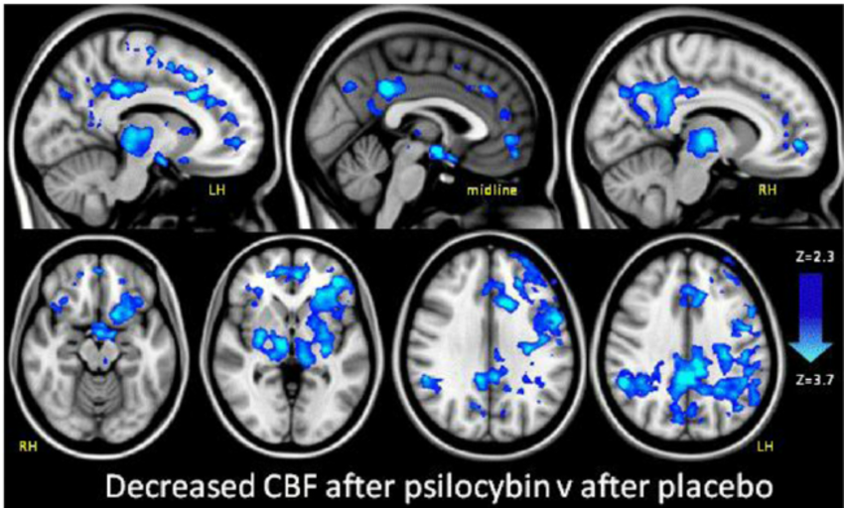
(Carhart-Harries 2012)
Blue = significant difference from placebo

Slide 26
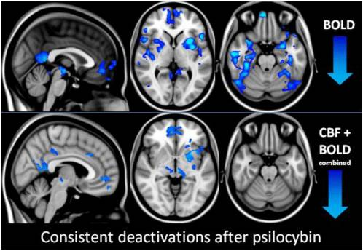
(Carhart-Harries 2012)
Decrease in CBF and BOLD in
Thalamus
Anterior cingulate cortex (ACC)
Posterior cingulate cortex (PCC)
Blue = significant difference from placebo

Slide 27
(weight and the size of the nodes is proportional to their strength)

Slide 28
Anxiety & Depression
Terminally ill cancer patients with anxiety
LSD + Psilocybin reduced anxiety associated with terminal cancer diagnoses
Treatment-resistant depression
2 doses of psilocybin reduced depression (12 individuals)
Therapeutic relief can last up to 6 months with one administration

Slide 29
Animal Models
1. 5-HT2A agonists (DOI) anxiolytic in the EPM
0.5, 1, 2 mg/kg
2. Facilitate fear conditioning and extinction depending on time of administration
3. Increase impulsivity in a D₂ dependent manner
4. Chronic LSD treatment → persistent behavioral abnormalities lasting long after drug administration ends

Slide 30
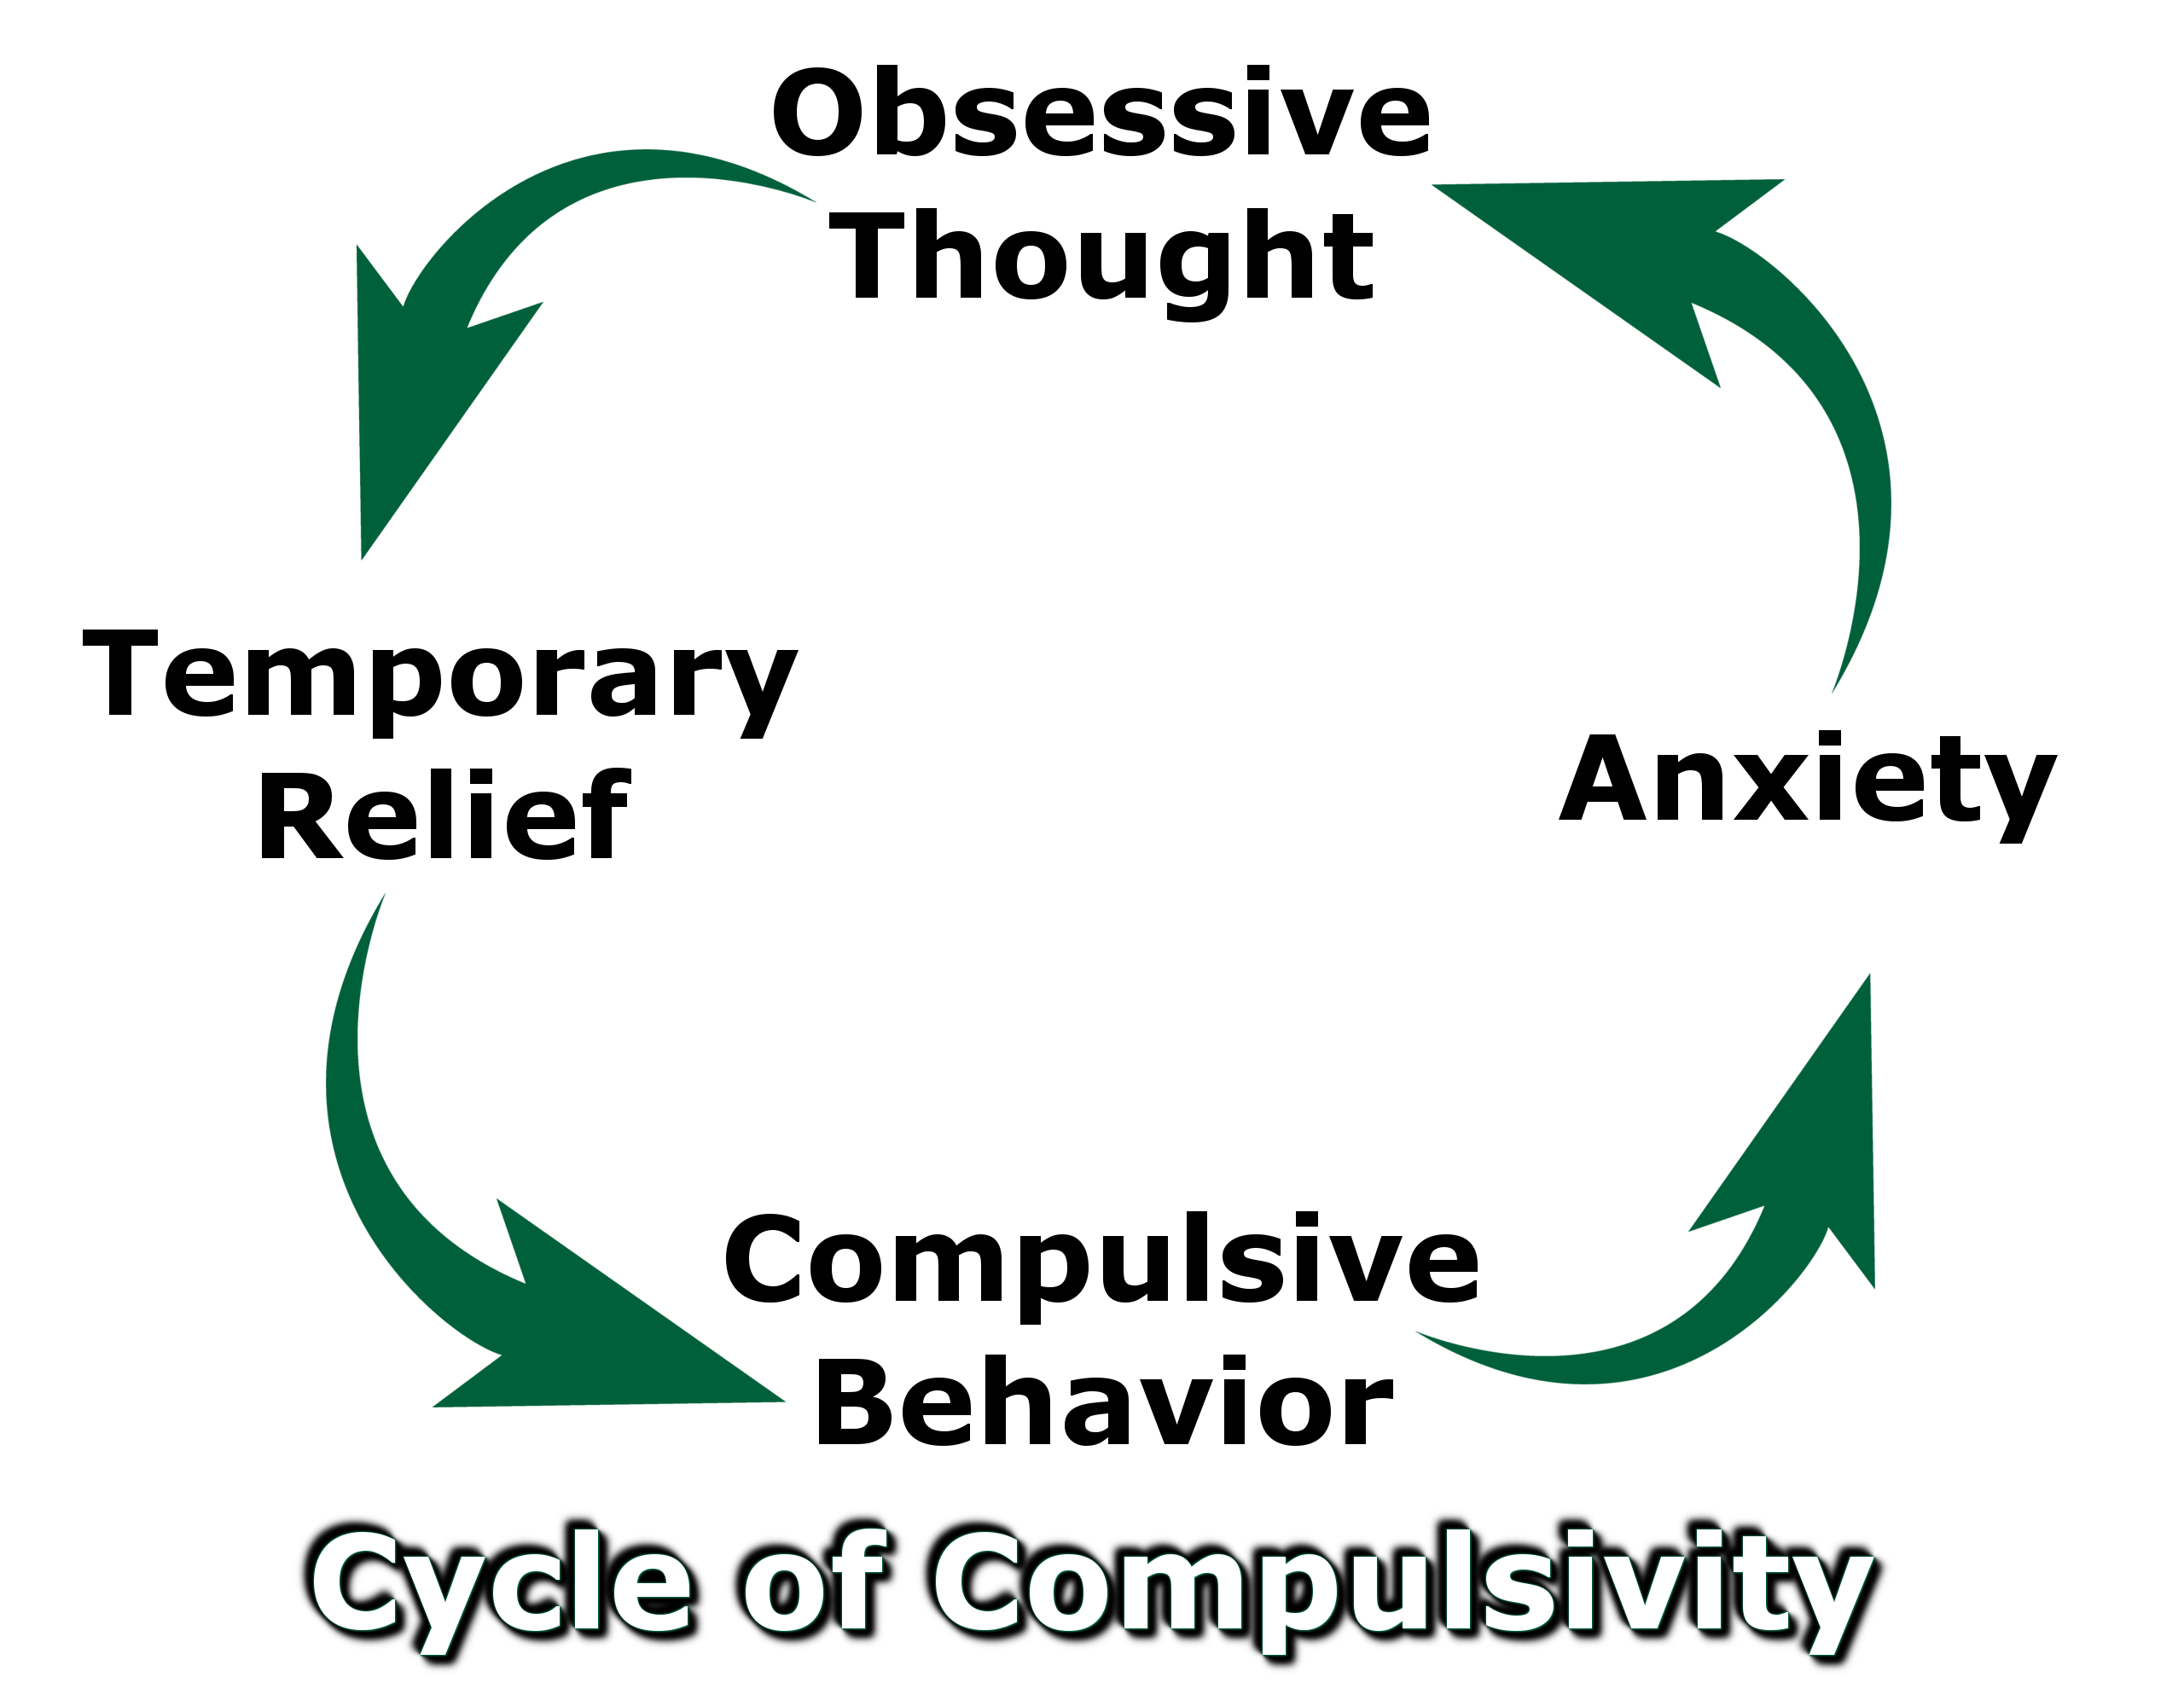
Obsessive Compulsive Disorder (OCD)
Decreased OCD symptoms (by 23–100%) on the Yale–brown obsessive compulsive scale
patients previously treatment resistant

Slide 31
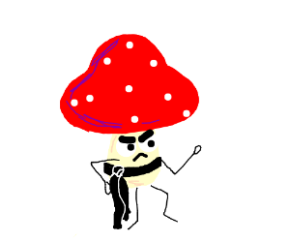
Addiction
Treatment for nicotine addiction and alcoholism

Slide 32
Inflammation
Repair mechanism recruited after a physical, chemical, thermal, or biological damage to remove the offensive agent and promote healing
Innate Immune Response – response within minutes to hours of injury
Recruit immune cells + inflammatory responses through cytokine release
Active Immune Response – recruited when innate response fails to eliminate agents
Recognize ‘self’ antigens from ‘non-self’ antigens

Slide 33
Pathological State of Immune System
Uncontrollable activation, inducing tissue destruction rather than healing.
Asthma. Allergic rhinitis, Autoimmune diseases, Type 1 diabetes, rheumatoid arthritis (RA), and lupus
Traditional treatments attempt to
prevent or decrease inflammation response
Suppress immune system
Key role in depression / addiction
Injections of proinflammatory agents TNF-α and IL-1β in healthy animals
- Behavior similar to social withdrawal

Slide 34
5-HT & Inflammation
Generally thought of as pro-inflammatory
5-HT depletion → ↓ inflammation
↑ 5-HT in blood associated with ↑ cytokines (IL-6 & TNF-α) & vice versa
5-HT_{2A} in
vascular smooth muscle
Activation = ↑ inflammatory cytokine IL-6
Inhibition = ↓IL-6

Slide 35
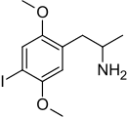
Psychedelics & Inflammation
DOI (and LSD) potently reduces TNF-α (rat smooth muscle cells)
- IC₅₀ concentrations 10–20 pM
Inhibited the TNF-a induced expression of genes encoding
Intracellular adhesion molecule-1 (ICAM-1),
Vascular cell adhesion molecule-1 (VCAM-1),
Blocked activation and nuclear translocation of NF-𝜅B
Blocked activation nitric oxide synthase activity
2,5-Dimethoy-4-iodoamphetamine
(DOI)

Slide 36
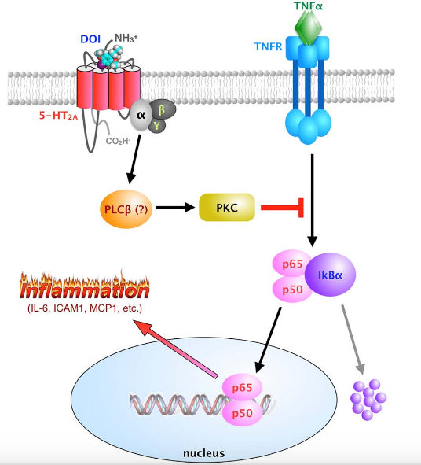
Proposed mechanism?

Slide 37
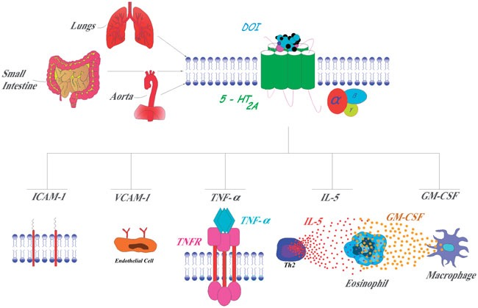
DOI in vivo
Mice injected ip - TNF-α
→ 2nd injection of either DOI, TNF-α,or Vehicle → tissues/blood taken
(R)-DOI treatment 0.3 mg/kg max dose
5 hours

Slide 38
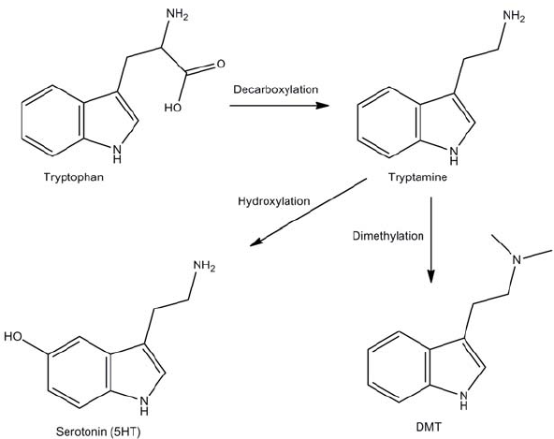
Dimethyltryptamine
Produced by many plants and mammal
Unknown biological role, very low endogenous levels
2 days treatment w/ irreversible MAO inhibitor → 10-15 pg/g (rats)
INMT
Widely expressed in mammalian tissues
Lungs, adrenals, thyroid, lymph nodes, placenta, heart, pancreas, retina, pineal gland

Slide 39
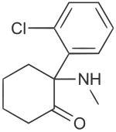
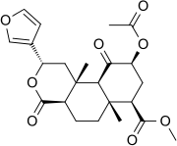
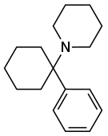
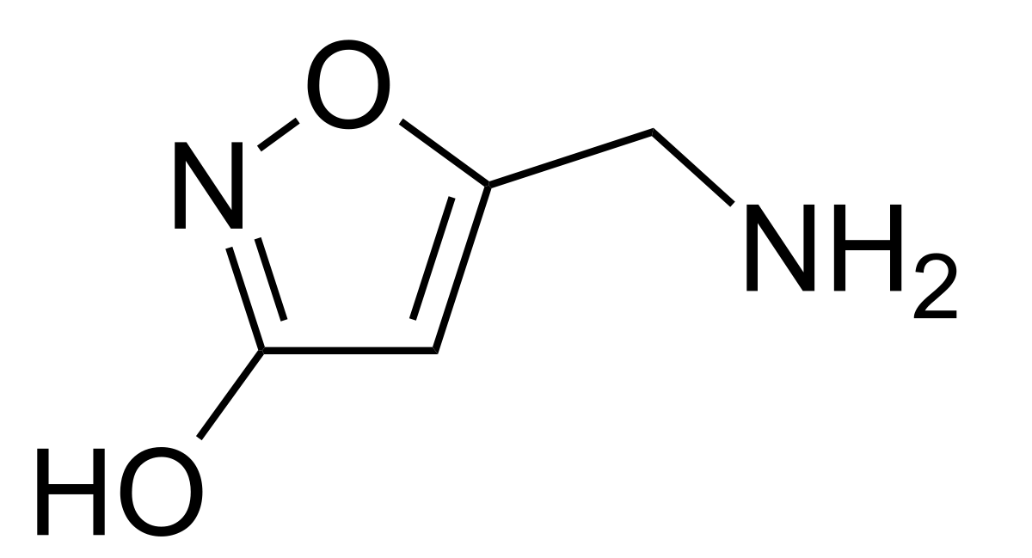
Dissociative
Ketamine [NMDA-R Antagonist]
Phencyclidine (PCP) [NMDA-R Antagonist]
Salvinorin A (𝜅-opioid agonist)
Muscimol (GABA_{A} agonist)
Ketamine
Salvinorin A
PCP
Deliriant
Muscimol

Slide 40
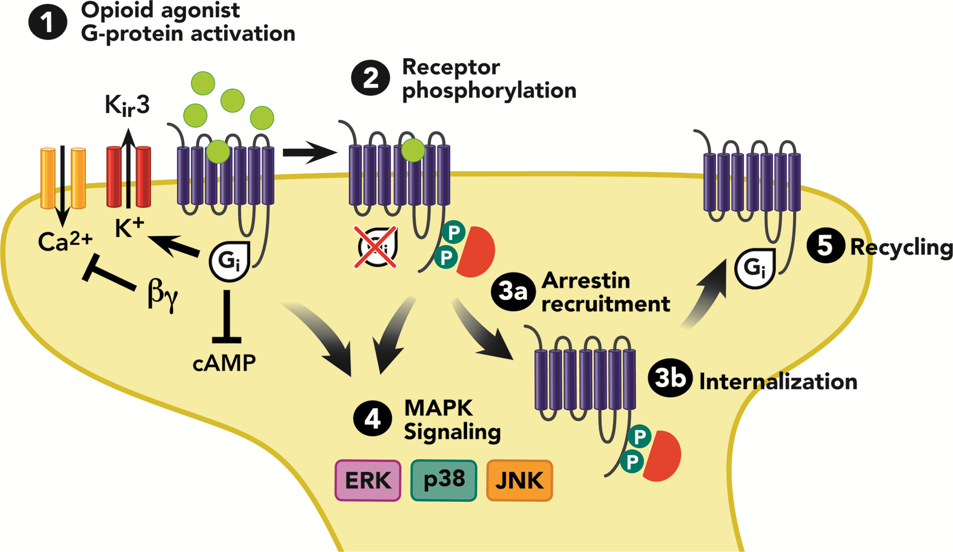
𝜅-Opioid Receptor

Slide 41
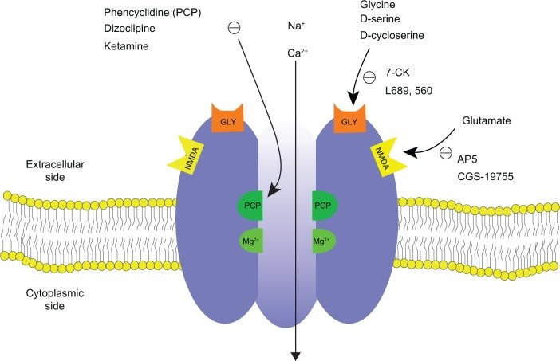
NMDA Receptor

Slide 42
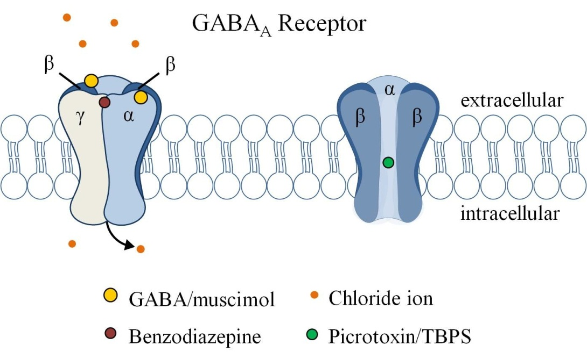
GABA_{A} Receptor

Slide 44
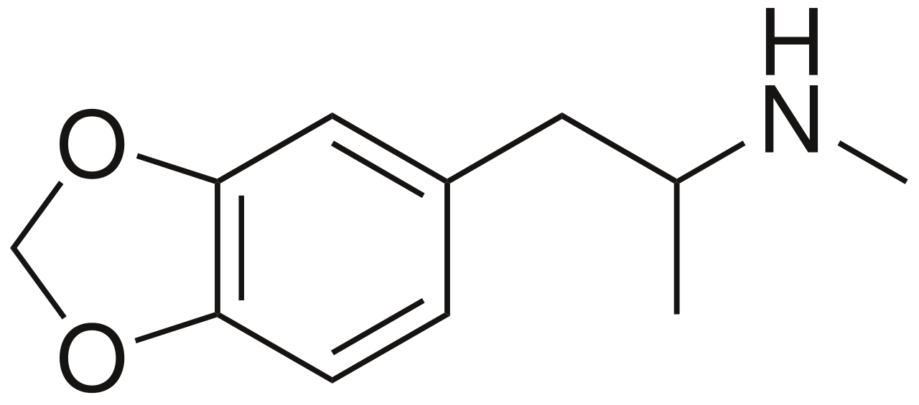
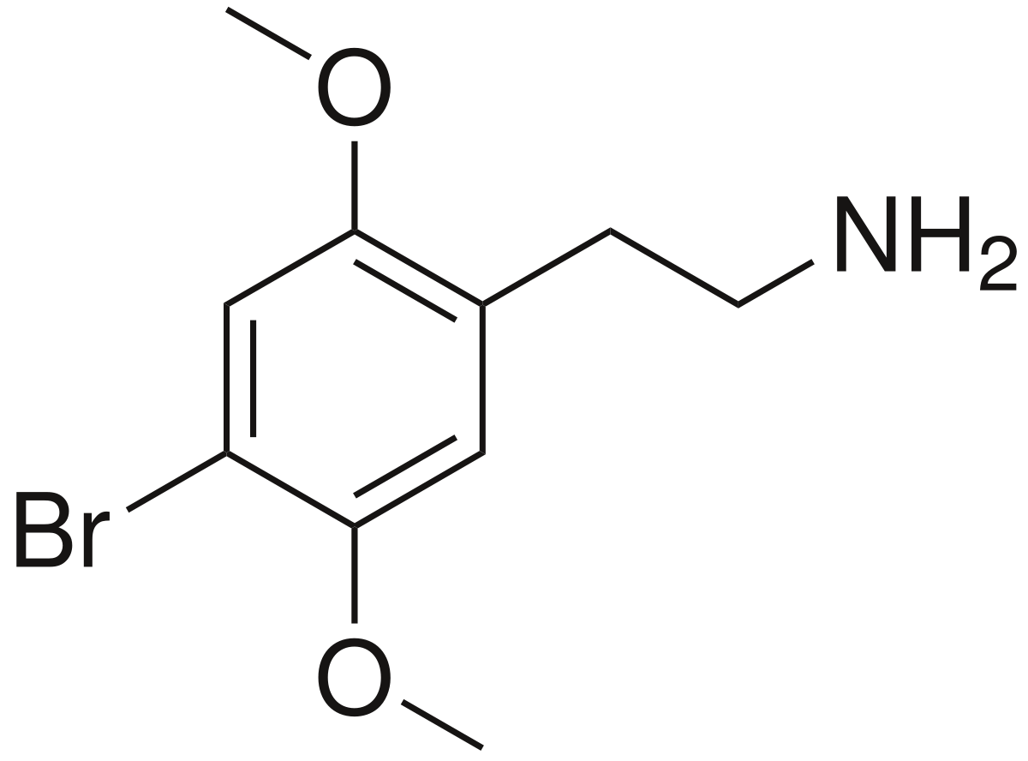
Entactogens
“The main characteristic that distinguishes MDMA from LSD-type experiences is the consistency of the effects of emotional communion, relatedness, emotional openness—in short, empathy and sympathy”
(Nichols, D. 1993)
MDMA
2C-B

Slide 45
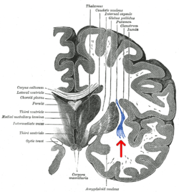
Claustrum
Bilateral grey matter structure
Consciousness / attention
High expression of
5-HT_{2A} + 𝜅-opioid receptors

Slide 46
Limitations
Placebo
Not prescribed medications
Patient screening / psychotherapy before drug administration

Slide 47
Other altered states of consciousness
Meditation
Prayer
Sensory deprivation
Breathing technique
Yoga, hypnotism
Chanting
Rituals

Slide 48
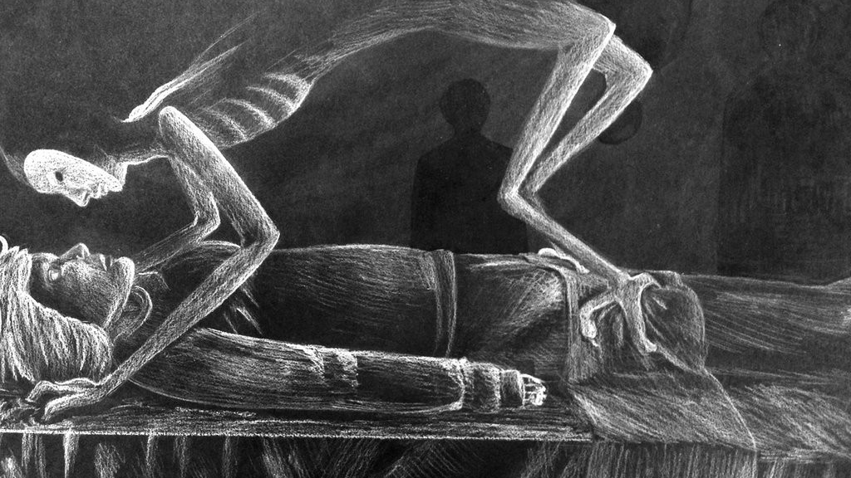
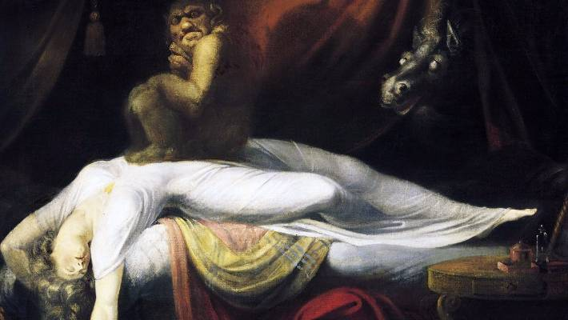
Sleep paralysis
Out-of-body experiences & hallucinations before/after sleep
”space aliens” and “shadow-people”
Implicated 5-HT2A activation (B. Jalal 2018)

Slide 49
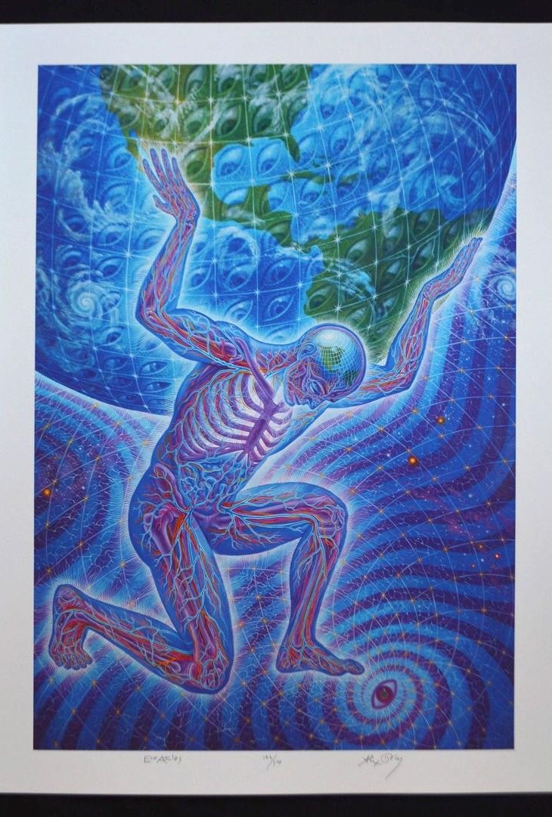
“Lifetime experience with (classic) psychedelics predicts pro-environmental behavior through an increase in nature relatedness” (Forstmann & Sagioglou 2017)
general population online survey
More likely to be concerned about environmental issues through nature relatedness and ecological behaviors like recycling, saving water
“Using structural equation modeling, found that experience with classic psychedelics uniquely predicted self-reported engagement in pro-environmental behaviors, and that this relationship was statistically explained by people’s degree of self-identification with nature”

